Slide 1
FINA 1303 PRICING OF FINANCIAL ASSETS
Veronique Lafon-Vinais
Associate Professor of Business Education - Department of Finance

Slide 2
Course Map
Overview
Foundations of
Interest Rates
Financial Institutions
Pricing of Financial Assets
Regulations
DCF
Sell Side
Buy Side
Stock
Valuation
Banking Regulation
Basics of
Interest Rates
Commercial Banking
Traditional Institutional Investors
Monetary Policy
Investment Banking
Alternative Investors

Slide 3
Course Map
Overview
Pricing of Financial Assets
Students will develop an understanding of:
What are Shares
Basics of Stocks
The Dividend Discount Model “DDM”
Stock
Valuation

Slide 4
What Are Shares
Shares (or stocks) represent a piece of ownership in a corporation
Shareholders rights:
Voting at shareholders meetings,
Dividends (if any),
Pro-rata of net assets in liquidation, i.e. residual claim once all debt has been paid,
There are sometimes different classes of shares: Common Shares and Preferred Shares…as well as Founders Shares
Different rights in respect of voting, dividends, claim on net assets.

Slide 5
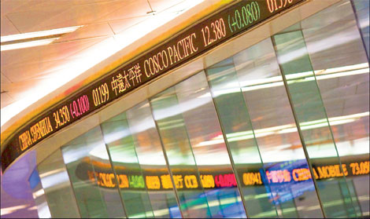
Stock Price Quote for Cathay Pacific http://www.google.com/finance?cid=671410
Ticker: 0293
D = dividend payment
EPS = earnings per share
P/E = price to earnings ratio
Mkt cap= market capitalization
Stock Basics

Slide 6
Shareholders Votes and Shareholders Meetings
Annual Meeting: once a year shareholders vote on directors and other proposals as well as ask managers questions. All shareholders have the right to attend the annual meeting and cast their shares directly (in accordance with their voting rights).
Proxy: a written authorization for someone else to vote your shares
Proxy Contest: when two or more groups are competing to collect proxies to prevail in a matter up to shareholders vote (such as the election of directors)
There are two main types of voting
Straight Voting: shareholders vote for each director separately, with each shareholder having as many votes as shares held
Cumulative Voting: each shareholder is allocated votes equal to the number of open spots multiplied by his/her number of shares (shareholder can allocate his vote to all or only some of the directors)
Stock Basics

Slide 7
Application: The Snap IPO
http://www.reuters.com/article/us-snap-ipo-idUSKBN1683BP?utm_source=Twitter&utm_medium=Social
Key facts:
Snapchat’s parent Snap listed on the NYSE at a price of $17 per share raising $2.6Bn and valuing the company at ~$24Bn
The price “popped” up to $24.48 a share at the close of the opening day, going up as much as $27
The company made no profits and didn’t expect to in the near future; it had negative free cash flow of $677 million
The shares sold to the public have no voting rights at all; Snap is the only company listed in NYSE with no voting rights
https://finance.yahoo.com/quote/SNAP/
Stock Basics

Slide 8
Preferred v. Common Shares
Preferred Stock: stock with preference over common shares in payment of dividends and in liquidation
Cumulative versus Non-Cumulative Preferred Stock:
cumulative = preferred stock where all the missed dividends must be paid before any common dividends can be paid;
non-cumulative = preferred stock where the missed dividends do not accumulate. Only the current dividend is owed before common dividends can be paid
Preferred Stock: Equity or Debt?
Generally no voting rights
Priority over common shareholders for payments of dividends and in liquidation
Behind bondholders & creditors in liquidation
Dividends paid after tax (US)
Stock Basics

Slide 9
The Mechanics of Stock Trades
Video: How NYSE works: https://www.youtube.com/watch?v=XRJBZIQrQAY
NYSE floor trading: https://www.youtube.com/watch?v=G_IK0Q1FCnk
Market Order = order at market (no specified price)
Limit Order = order at specific price
Round Lot = 100 shares
Most exchanges today are fully electronic; NYSE is one of the very few that still has floor trading: specialists hold trading licenses and make markets in some securities: floor brokers represent customers orders on the floor
Remember each exchange has its own rules! Before you start trading, check out the rules of the exchange!
Stock Basics

Slide 10
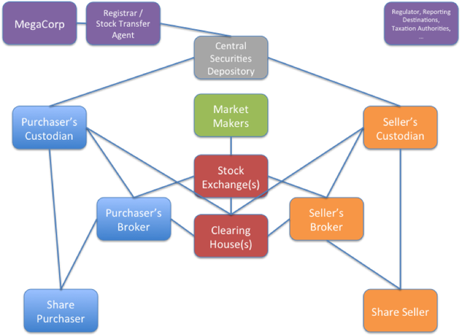
How trades work
Stock Trades
Notes:
Source: https://gendal.me/2014/01/05/a-simple-explanation-of-how-shares-move-around-the-securities-settlement-system/

Slide 11
Equity Valuation: the Dividend-Discount Model “DDM”
How do we value listed shares or stocks?
We will apply what we learned from DCF to cash flows arising from shares/stocks

Slide 12
DDM
With a 1 year time horizon, an investor buys a listed stock today (time=0) at market price P₀, gets a dividend Div₁ after 1 year and sells the stock at then market price P₁,
So the cash flows consist of Div₁ the dividend
and P₁ the sale price of the stock
Discounting the cash flows with the expected return r_{E} leads to:
Notice that the price of the stock P₀ is the PV of the expected cash flows from the stock (we are simply applying what we learned in DCF !)

Slide 13
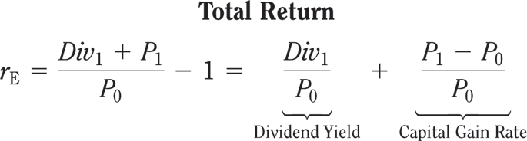
DDM
Dividend Yields, Capital Gains, and Total Returns
Dividend Yield: expected annual dividend of a stock divided by its current price = % return an investor expects to earn from the dividend paid by the stock
Capital Gain: the amount by which the selling price of the stock exceeds the purchase price
Capital Gains Rate: capital gain as % of initial price of the stock
Total Return: stock’s dividend yield plus capital gain rate

Slide 14
DDM
So when buying that stock at P₀, the expected return r_{E} can be broken down as:
If expected Dividend Yield + expected Capital Gain Return ≥ expected return (hurdle rate) of the investor, then the investor should buy that stock.

Slide 15
Example: Stock Prices and Returns
Suppose you expect Funky Gold Company (FGC) to pay an annual dividend of $0.56 per share in the coming year and to trade at $45.50 per share at the end of the year.
If investments with equivalent risk to FGC’ stock have an expected return of 6.80%, what is the most you would pay today for FGC’s stock?
What dividend yield and capital gain rate would you expect at this price?

Slide 16
Example : Stock Prices and Returns
Solution:
We solve for the beginning price we would pay now (P₀) given our expectations about dividends (Div₁=$0.56) and future price (P₁=$45.50) and the return we expect to earn to be willing to invest (r_{E}=0.068).
We can calculate the dividend yield and capital gain rate

Slide 17
Example : Stock Prices and Returns
Execute:
We see that at this price, FGCs’ dividend yield is Div₁/P₀ = 0.56/43.13 = 1.30%.
The expected capital gain is $45.50 - $43.13 = $2.37 per share, for a capital gain rate of 2.37/43.13 = 5.50%.

Slide 18
Example : Stock Prices and Returns
Evaluate:
At a price of $43.13, FGCs’ expected total return is 1.30% + 5.50% = 6.80%, which is equal to its equity cost of capital (the return being paid by investments with equivalent risk to FGCs’).
This amount of $43.13 is the most we would be willing to pay for FGCs’ stock.
If we paid more, our expected return would be less than 6.8% and we would rather invest elsewhere.

Slide 19
Your Turn!
Problem:
Suppose you expect Koch Industries to pay an annual dividend of $2.31 per share in the coming year and to trade at $82.75 per share at the end of the year.
If investments with equivalent risk to Koch’s stock have an expected return of 8.9%, what is the most you would pay today for Koch’s stock?
What dividend yield and capital gain rate would you expect at this price?
FINA 5120 – DDM
Copyright ©2015 Pearson Education, Inc. All rights reserved.

Slide 20

Test Your Understanding
The stock price we are willing to pay is:
69.5
78.11
85.9
The dividend yield is:
2.96%
5.94%
8.90%
The capital gain rate is:
2.96%
5.94%
8.90%

Slide 21
Solution
We can solve for the beginning price we would pay now (P0) given our expectations about dividends (Div1=2.31) the future price (P1=$82.75) and the return (rE=8.9%) we expect to earn to be willing to invest.
We can calculate the dividend yield and capital gain.
Copyright ©2015 Pearson Education, Inc. All rights reserved.

Slide 22
Solution
Execute:
At this price, Koch’s dividend yield is Div₁/P₀ = 2.31/78.11 = 2.96%.
The expected capital gain is $82.75 - $78.11 = $4.64 per share, for a capital gain rate of 4.64/78.11 = 5.94%.
At a price of $78.11, Koch’s expected total return is 2.96% + 5.94% = 8.90%, which is equal to its equity cost of capital (the return being paid by investments with equivalent risk to Koch’s).
This amount is the most we would be willing to pay for Koch’s stock. If we paid more, our expected return would be less than 8.9% and we would rather invest elsewhere.
Copyright ©2015 Pearson Education, Inc. All rights reserved.
Notes:
Evaluate:
At a price of $78.11, Koch’s expected total return is 2.96% + 5.94% = 8.90%, which is equal to its equity cost of capital (the return being paid by investments with equivalent risk to Koch’s).
This amount is the most we would be willing to pay for Koch’s stock. If we paid more, our expected return would be less than 8.9% and we would rather invest elsewhere.

Slide 23
Test Your Understanding
Expected share price (P₁): $50
Expected dividend (Div₁): $0.50
Expected rate of return (r_{E}): 5%
Calculate P₀
The correct answer is:
49.5
48.10
55

Slide 24
Test Your Understanding (ctd)
Calculate the dividend yield :Div₁ / P₀
Possible answers:
1.05%
1.04%
1.03%
Calculate capital gain P₁ - P₀
Possible answers
1.8
1.9
2.1

Slide 25

Test Your Understanding (ctd)
What is the capital gain return (capital gain/ P₀ )?
Possible answers:
3.81
3.96
4.10
From the answers above, calculate the total return/expected return (dividend yield + capital gain rate)
Possible answers:
4.5%
5%
5.5%

Slide 26
DDM
With 2 years time horizon, an investor buys the stock today at P₀, gets dividends Div₁ & Div₂ in years 1 & 2, and then sells the stock at P₂ in year 2,
Discounting the cash flows with the expected return r_{E} leads to:
not different from applying the 1 year calculation twice

Slide 27
DDM
Buying a stock at P₀ and selling at P_{n} in year n, collecting dividends in between, the DCF formula applies:
Considering that investors buying the stock at P_{n} in year n follow the same logic, we can push it to infinity leading to a valuation of:
The stock price is the Present Value of all the expected future dividends

Slide 28
DDM – Constant Dividend Growth
When the dividend growth g is constant, the DCF calculation is simpler:
Simplified calculations lead to the Constant Dividend Growth Model (when r_{E} > g): (notice this is exactly what we learned before for perpetuals!)

Slide 29
Example : Valuing a Firm with Constant Dividend Growth
Suppose Great China Inc (GCI) plans to pay $2.30 per share in dividends in the coming year.
If the expected rate of return is 7% and dividends are expected to grow by 2% per year in the future, estimate the value of GCI’s stock today.

Slide 30
Example : Valuing a Firm with Constant Dividend Growth
Solution:
Because the dividends are expected to grow perpetually at a constant rate, we can calculate the price P₀ of GCI.
The next dividend (Div₁) is expected to be $2.30, the growth rate (g) is 2% and the expected return (r_{E}) is 7%.

Slide 31
Example : Valuing a Firm with Constant Dividend Growth
Execute:
You would be willing to pay $46, that is to say 20 times this year’s dividend of $2.30, to own GCI stock today because you are buying claim to this year’s dividend and to an infinite growing series of future dividends.

Slide 32
Your Turn!
Problem:
Suppose Target Corporation plans to pay $0.68 per share in dividends in the coming year.
If its equity cost of capital is 10% and dividends are expected to grow by 8.4% per year in the future, estimate the value of Target’s stock.
Copyright ©2015 Pearson Education, Inc. All rights reserved.

Slide 33
Test Your Understanding
Target’s stock price (P₀ ) is:
42.50
53.45
68.59

Slide 34
Solution
Because the dividends are expected to grow perpetually at a constant rate, we can value Target.
The next dividend (Div₁) is expected to be $0.68, the growth rate (g) is 8.4% and the equity cost of capital (r_{E}) is 10%.
Copyright ©2015 Pearson Education, Inc. All rights reserved.

Slide 35
Solution
Execute:
Evaluate:
You would be willing to pay 62.5 times this year’s dividend of $0.68 to own Target stock because you are buying claim to this year’s dividend and to an infinite growing series of future dividends.
Copyright ©2015 Pearson Education, Inc. All rights reserved.

Slide 36
Test Your Understanding
Problem:
Suppose Gold Trading Company (GTC) plans to pay $0.50 (Div₁ ) per share in dividends in the coming year.
If the expected rate of return (r_{E} ) is 8% and dividends are expected to grow (g) by 4% per year in the future, estimate the value (P₀) of GTC’s stock today.

Slide 37
Test Your Understanding
Calculate P₀
Possible answers:
11.60
12.50
13.45

Slide 38
Limitations of the Dividend-Discount Model
Value Drivers and the Dividend-Discount Model
The dividend-discount model includes an implicit forecast of the firm’s profitability which is discounted back at the firm’s equity cost of capital
Uncertain Dividend Forecasts
The dividend-discount model values a stock based on a forecast of the future dividends, but a firm’s future dividends carry a tremendous amount of uncertainty
Remember to question the assumptions you make when doing your forecasts.
Practitioners will typically run sensitivity analysis on key assumptions

Slide 39
DDM – What To Keep In Mind
Constant Dividend Growth Model formula applies only when r_{E} > g,
The expected return from a stock investment over 1 year is
for listed companies there is a trade-off between increasing dividends and growth rate, assuming unchanged earnings, it depends on
a) dividend payout rate and
b) number of shares outstanding (share repurchases)
For stocks with uncertain dividend or paying no dividend, DDM is of limited help.

Slide 40
In summary: the Dividend-Discount Model
Copyright ©2015 Pearson Education, Inc. All rights reserved.

Slide 41
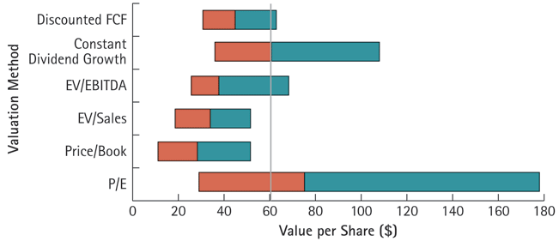
Range of Valuations for Nike Stock Using Various Valuation Methods
Comps
Copyright ©2015 Pearson Education, Inc. All rights reserved.

Slide 42
Your Turn!
NoGrowth Industries presently pays an annual dividend of $1.20 per share and it is expected that these dividend payments will continue indefinitely. If NoGrowth's equity cost of capital is 10%, then the value of a share of NoGrowth's stock is closest to ________.
A) $9.60
B) $14.40
C) $13.20
D) $12.00
Answer D

Slide 43
Solution to Question 1
The value of a share of NoGrowth's stock is closest to $12.

